Slide 1
Geometric 3D Object Rendering

Slide 2
GLUT includes a number of routines for generating easily recognizable 3D geometric objects
1. Solid Sphere, Wire Sphere
glutSolidSphere (double radius, int slices, int stacks)
glutWireSphere (double radius, int slices, int stacks)
Renders a sphere centered at the modeling coordinates origin of the specified radius.
The sphere is subdivided around the Z axis into slices and along the Z axis into stacks.

Slide 3
Where:
radius is the radius of the sphere
slices is the number of subdivisions around the Z axis (similar to lines of longitude)
stacks is the number of subdivisions along the Z axis (similar to lines of latitude)

Slide 4
Program (Solid Sphere)
#include <GL/glut.h>
void init(void) {
glClearColor (0.0, 0.0, 0.0, 0.0);
glShadeModel (GL_FLAT);
}
void display(void) {
glClear (GL_COLOR_BUFFER_BIT);
glColor3f (1.0, 0.0, 1.0);
glLoadIdentity (); /* clear the matrix */
/* viewing transformation */
gluLookAt (0.0, 0.0, 5.0, 0.0, 0.0, 0.0, 0.0, 1.0, 0.0);
glScalef (1.0, 2.0, 1.0); /* modeling transformation */
glutSolidSphere (0.4, 16, 16);
glFlush ();
}

Slide 5
void reshape (int w, int h){
glViewport (0, 0, (GLsizei) w, (GLsizei) h);
glMatrixMode (GL_PROJECTION);
glLoadIdentity ();
glFrustum (-1.0, 1.0, -1.0, 1.0, 1.5, 20.0);
glMatrixMode (GL_MODELVIEW);
}
int main(int argc, char** argv) {
glutInit(&argc, argv);
glutInitDisplayMode (GLUT_SINGLE | GLUT_RGB);
glutInitWindowSize (500, 500);
glutInitWindowPosition (100, 100);
glutCreateWindow (argv[0]);

Slide 6
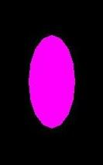
init ();
glutDisplayFunc(display);
glutReshapeFunc(reshape);
glutMainLoop();
return 0;
}
Output

Slide 7
Program (Wire Sphere)
#include <GL/glut.h>
void init(void) {
glClearColor (0.0, 0.0, 0.0, 0.0);
glShadeModel (GL_FLAT);
}
void display(void) {
glClear (GL_COLOR_BUFFER_BIT);
glColor3f (1.0, 0.0, 1.0);
glLoadIdentity (); /* clear the matrix */
/* viewing transformation */
gluLookAt (0.0, 0.0, 5.0, 0.0, 0.0, 0.0, 0.0, 1.0, 0.0);
glScalef (1.0, 2.0, 1.0); /* modeling transformation */
glutWireSphere (0.4, 16, 16);
glFlush ();
}

Slide 8
void reshape (int w, int h){
glViewport (0, 0, (GLsizei) w, (GLsizei) h);
glMatrixMode (GL_PROJECTION);
glLoadIdentity ();
glFrustum (-1.0, 1.0, -1.0, 1.0, 1.5, 20.0);
glMatrixMode (GL_MODELVIEW);
}
int main(int argc, char** argv) {
glutInit(&argc, argv);
glutInitDisplayMode (GLUT_SINGLE | GLUT_RGB);
glutInitWindowSize (500, 500);
glutInitWindowPosition (100, 100);
glutCreateWindow (argv[0]);

Slide 9
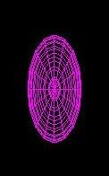
init ();
glutDisplayFunc(display);
glutReshapeFunc(reshape);
glutMainLoop();
return 0;
}
Output

Slide 10
2. Solid Teapot, Wire Teapot
Program (Solid Teapot)
#include <GL/glut.h>
void init(void) {
glClearColor (0.0, 0.0, 0.0, 0.0);
glShadeModel (GL_FLAT);
}
void display(void) {
glClear (GL_COLOR_BUFFER_BIT);
glColor3f (1.0, 0.0, 1.0);
glLoadIdentity (); /* clear the matrix */
/* viewing transformation */
gluLookAt (0.0, 0.0, 5.0, 0.0, 0.0, 0.0, 0.0, 1.0, 0.0);
glScalef (1.0, 2.0, 1.0); /* modeling transformation */
glutSolidTeapot (1.0);
glFlush ();
}

Slide 11
void reshape (int w, int h){
glViewport (0, 0, (GLsizei) w, (GLsizei) h);
glMatrixMode (GL_PROJECTION);
glLoadIdentity ();
glFrustum (-1.0, 1.0, -1.0, 1.0, 1.5, 20.0);
glMatrixMode (GL_MODELVIEW);
}
int main(int argc, char** argv) {
glutInit(&argc, argv);
glutInitDisplayMode (GLUT_SINGLE | GLUT_RGB);
glutInitWindowSize (500, 500);
glutInitWindowPosition (100, 100);
glutCreateWindow (argv[0]);

Slide 12
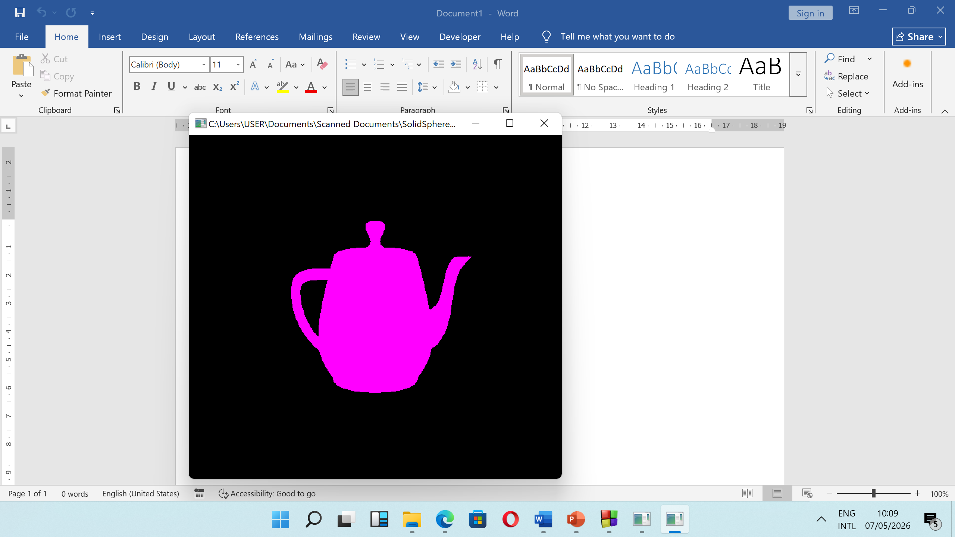
init ();
glutDisplayFunc(display);
glutReshapeFunc(reshape);
glutMainLoop();
return 0;
}
Output

Slide 13
Program (Wire Teapot)
#include <GL/glut.h>
void init(void) {
glClearColor (0.0, 0.0, 0.0, 0.0);
glShadeModel (GL_FLAT);
}
void display(void) {
glClear (GL_COLOR_BUFFER_BIT);
glColor3f (1.0, 0.0, 1.0);
glLoadIdentity (); /* clear the matrix */
/* viewing transformation */
gluLookAt (0.0, 0.0, 5.0, 0.0, 0.0, 0.0, 0.0, 1.0, 0.0);
glScalef (1.0, 2.0, 1.0); /* modeling transformation */
glutWireTeapot (1.0);
glFlush ();
}

Slide 14
void reshape (int w, int h){
glViewport (0, 0, (GLsizei) w, (GLsizei) h);
glMatrixMode (GL_PROJECTION);
glLoadIdentity ();
glFrustum (-1.0, 1.0, -1.0, 1.0, 1.5, 20.0);
glMatrixMode (GL_MODELVIEW);
}
int main(int argc, char** argv) {
glutInit(&argc, argv);
glutInitDisplayMode (GLUT_SINGLE | GLUT_RGB);
glutInitWindowSize (500, 500);
glutInitWindowPosition (100, 100);
glutCreateWindow (argv[0]);

Slide 15
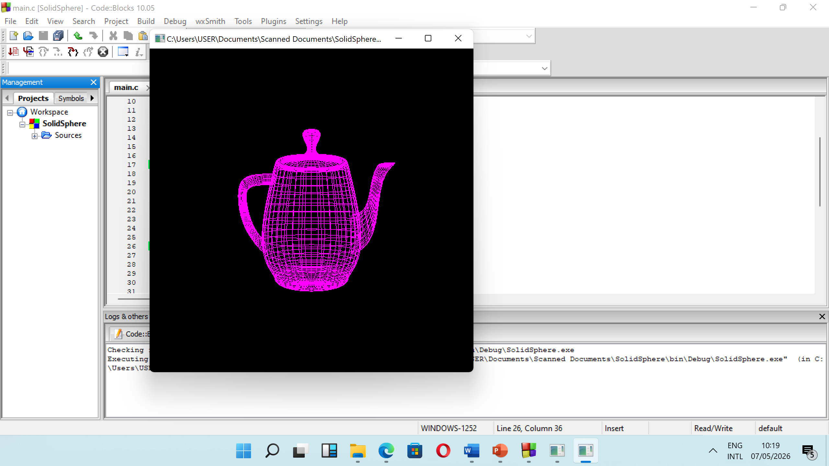
init ();
glutDisplayFunc(display);
glutReshapeFunc(reshape);
glutMainLoop();
return 0;
}
Output

Slide 16
3. glutSolidTorus, glutWireTorus
glutSolidTorus and glutWireTorus render a solid or wireframe torus (doughnut) respectively, centered at the modeling coordinates origin whose axis is aligned with the Z axis.
Usage
void glutSolidTorus(GLdouble innerRadius,
GLdouble outerRadius,
GLint nsides, GLint rings);
void glutWireTorus(GLdouble innerRadius,
GLdouble outerRadius,
GLint nsides, GLint rings);

Slide 17
Where:
innerRadius is the Inner radius of the torus.
outerRadius is the Outer radius of the torus.
Nsides is the Number of sides for each radial section.
Rings is the Number of radial divisions for the torus.

Slide 18
Program (Solid Torus)
#include <GL/glut.h>
void init(void) {
glClearColor (0.0, 0.0, 0.0, 0.0);
glShadeModel (GL_FLAT);
}
void display(void) {
glClear (GL_COLOR_BUFFER_BIT);
glColor3f (1.0, 0.0, 1.0);
glLoadIdentity (); /* clear the matrix */
/* viewing transformation */
gluLookAt (0.0, 0.0, 5.0, 0.0, 0.0, 0.0, 0.0, 1.0, 0.0);
glScalef (1.0, 2.0, 1.0); /* modeling transformation */
glutSolidTorus(0.5,1.5,10,10);
glFlush ();
}

Slide 19
void reshape (int w, int h){
glViewport (0, 0, (GLsizei) w, (GLsizei) h);
glMatrixMode (GL_PROJECTION);
glLoadIdentity ();
glFrustum (-1.0, 1.0, -1.0, 1.0, 1.5, 20.0);
glMatrixMode (GL_MODELVIEW);
}
int main(int argc, char** argv) {
glutInit(&argc, argv);
glutInitDisplayMode (GLUT_SINGLE | GLUT_RGB);
glutInitWindowSize (500, 500);
glutInitWindowPosition (100, 100);
glutCreateWindow (argv[0]);

Slide 20
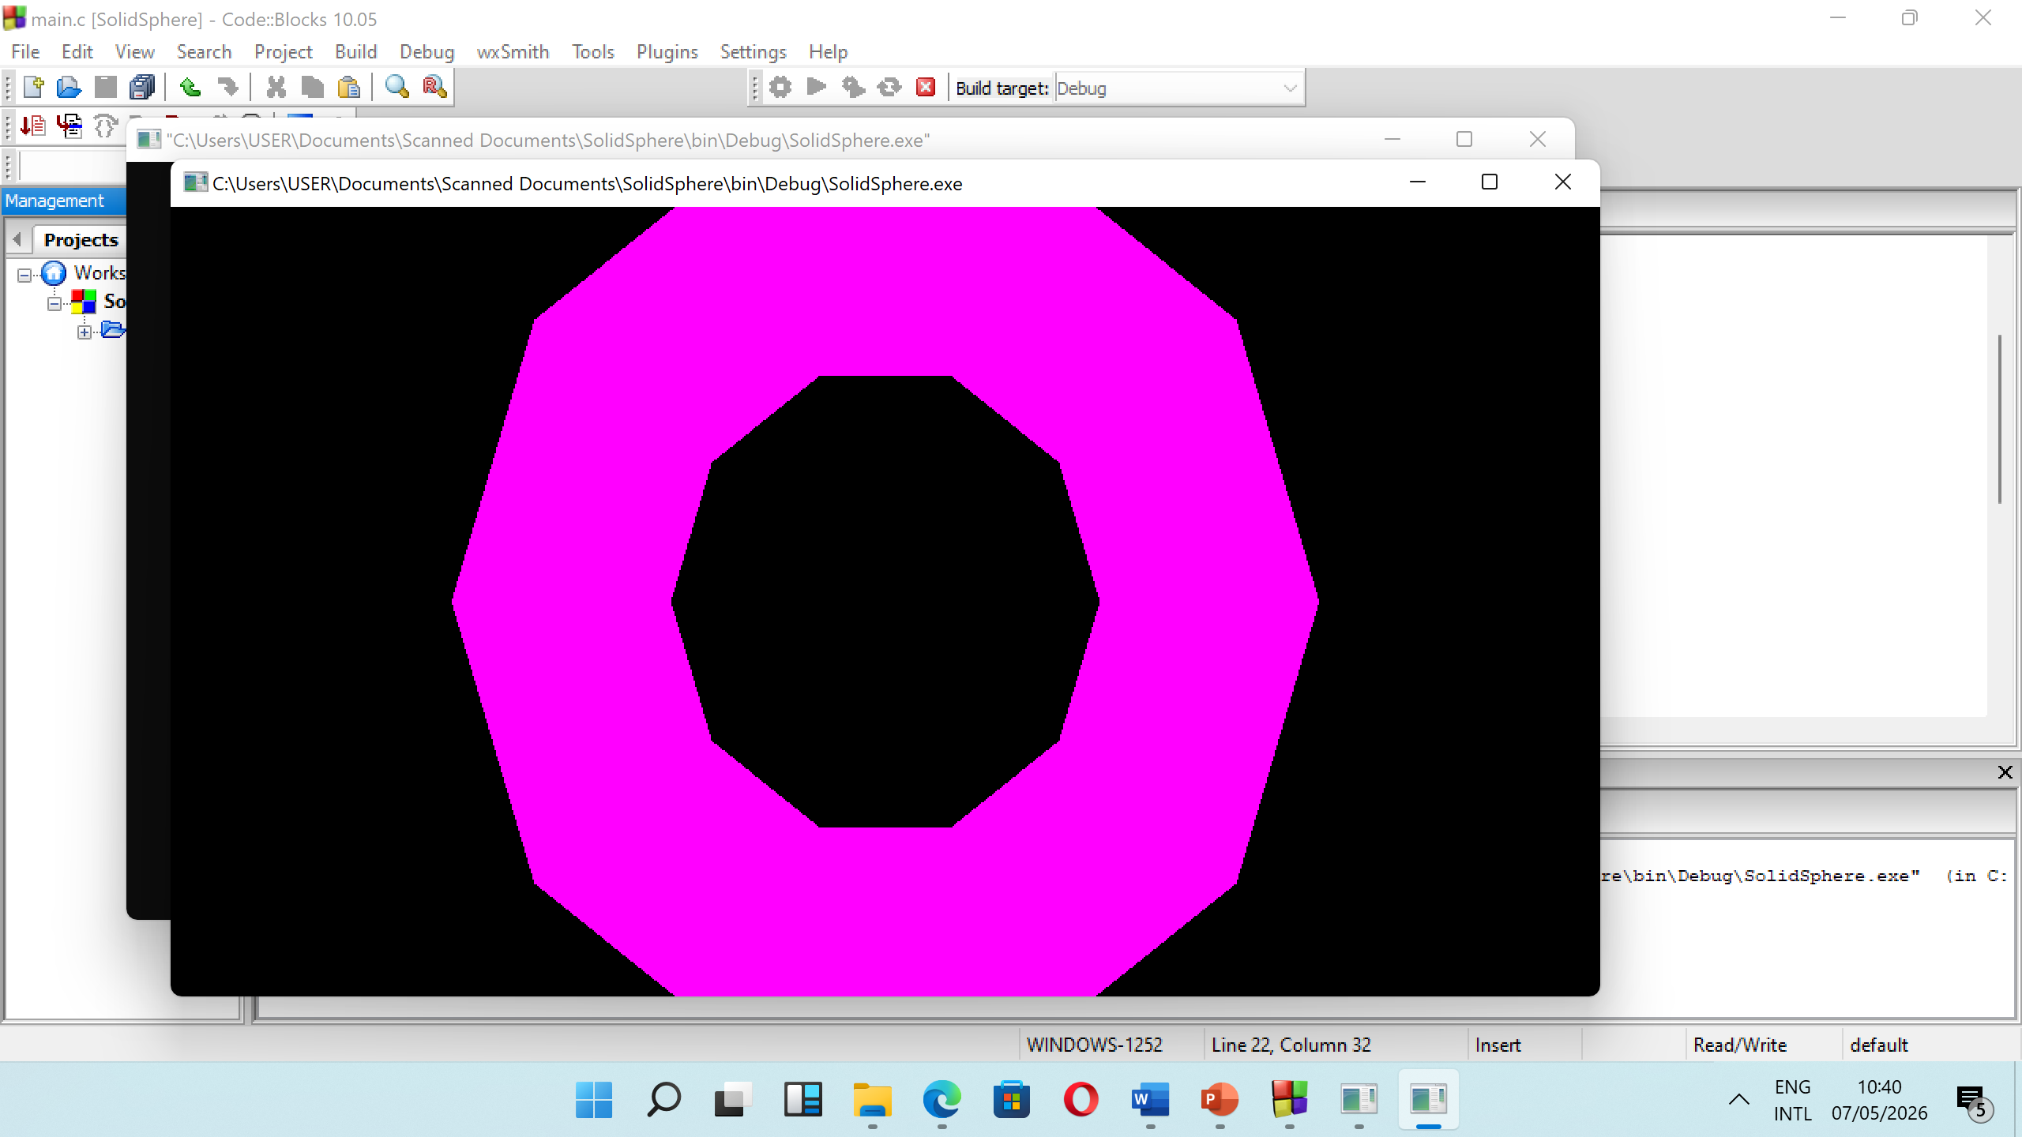
init ();
glutDisplayFunc(display);
glutReshapeFunc(reshape);
glutMainLoop();
return 0;
}
Output

Slide 21
Program (Wire Torus)
#include <GL/glut.h>
void init(void) {
glClearColor (0.0, 0.0, 0.0, 0.0);
glShadeModel (GL_FLAT);
}
void display(void) {
glClear (GL_COLOR_BUFFER_BIT);
glColor3f (1.0, 0.0, 1.0);
glLoadIdentity (); /* clear the matrix */
/* viewing transformation */
gluLookAt (0.0, 0.0, 5.0, 0.0, 0.0, 0.0, 0.0, 1.0, 0.0);
glScalef (1.0, 2.0, 1.0); /* modeling transformation */
glutSolidTorus(0.5,1.5,10,10);
glFlush ();
}

Slide 22
void reshape (int w, int h){
glViewport (0, 0, (GLsizei) w, (GLsizei) h);
glMatrixMode (GL_PROJECTION);
glLoadIdentity ();
glFrustum (-1.0, 1.0, -1.0, 1.0, 1.5, 20.0);
glMatrixMode (GL_MODELVIEW);
}
int main(int argc, char** argv) {
glutInit(&argc, argv);
glutInitDisplayMode (GLUT_SINGLE | GLUT_RGB);
glutInitWindowSize (500, 500);
glutInitWindowPosition (100, 100);
glutCreateWindow (argv[0]);

Slide 23
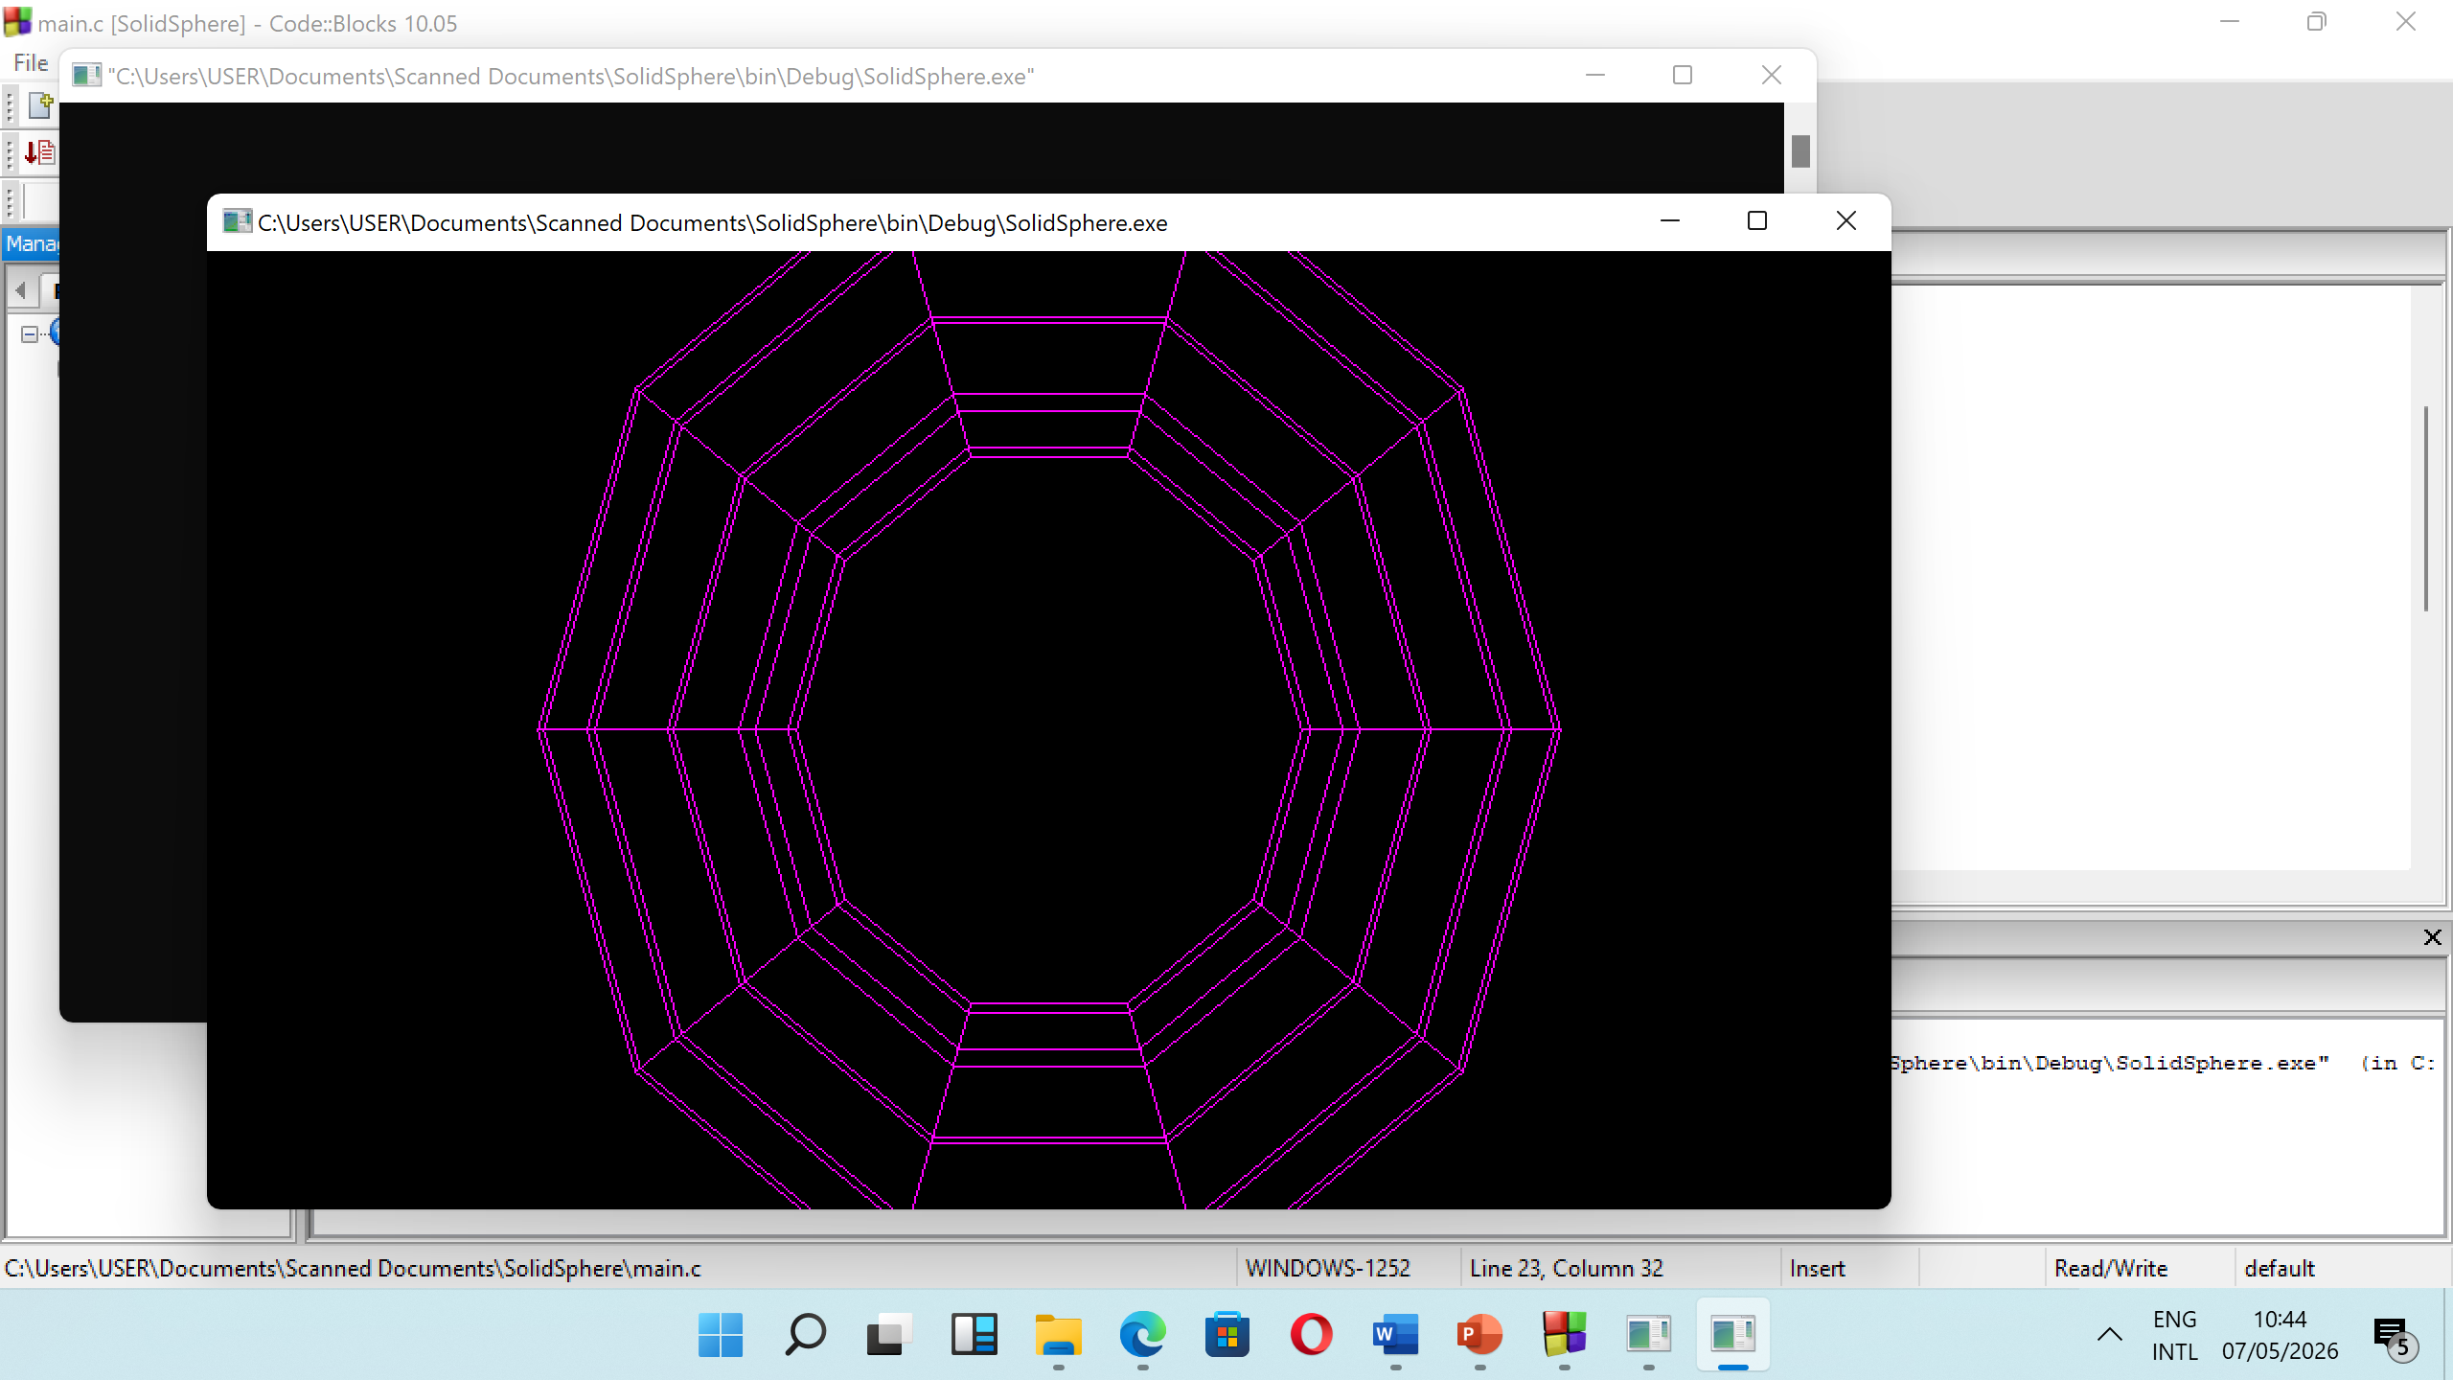
init ();
glutDisplayFunc(display);
glutReshapeFunc(reshape);
glutMainLoop();
return 0;
}
Output

Slide 24
3. glutSolidDodecahedron, glutWireDodecahedron
glutSolidDodecahedron and glutWireDodecahedron render a solid or wireframe dodecahedron (12-sided regular solid) respectively.
Usage
void glutSolidDodecahedron(void);
void glutWireDodecahedron(void);

Slide 25
Program (Solid Dodecahedron)
#include <GL/glut.h>
void init(void) {
glClearColor (0.0, 0.0, 0.0, 0.0);
glShadeModel (GL_FLAT);
}
void display(void) {
glClear (GL_COLOR_BUFFER_BIT);
glColor3f (1.0, 0.0, 1.0);
glLoadIdentity (); /* clear the matrix */
/* viewing transformation */
gluLookAt (0.0, 0.0, 5.0, 0.0, 0.0, 0.0, 0.0, 1.0, 0.0);
glScalef (1.0, 2.0, 1.0); /* modeling transformation */
glutSolidDodecahedron();
glFlush ();
}

Slide 26
void reshape (int w, int h){
glViewport (0, 0, (GLsizei) w, (GLsizei) h);
glMatrixMode (GL_PROJECTION);
glLoadIdentity ();
glFrustum (-1.0, 1.0, -1.0, 1.0, 1.5, 20.0);
glMatrixMode (GL_MODELVIEW);
}
int main(int argc, char** argv) {
glutInit(&argc, argv);
glutInitDisplayMode (GLUT_SINGLE | GLUT_RGB);
glutInitWindowSize (500, 500);
glutInitWindowPosition (100, 100);
glutCreateWindow (argv[0]);

Slide 27
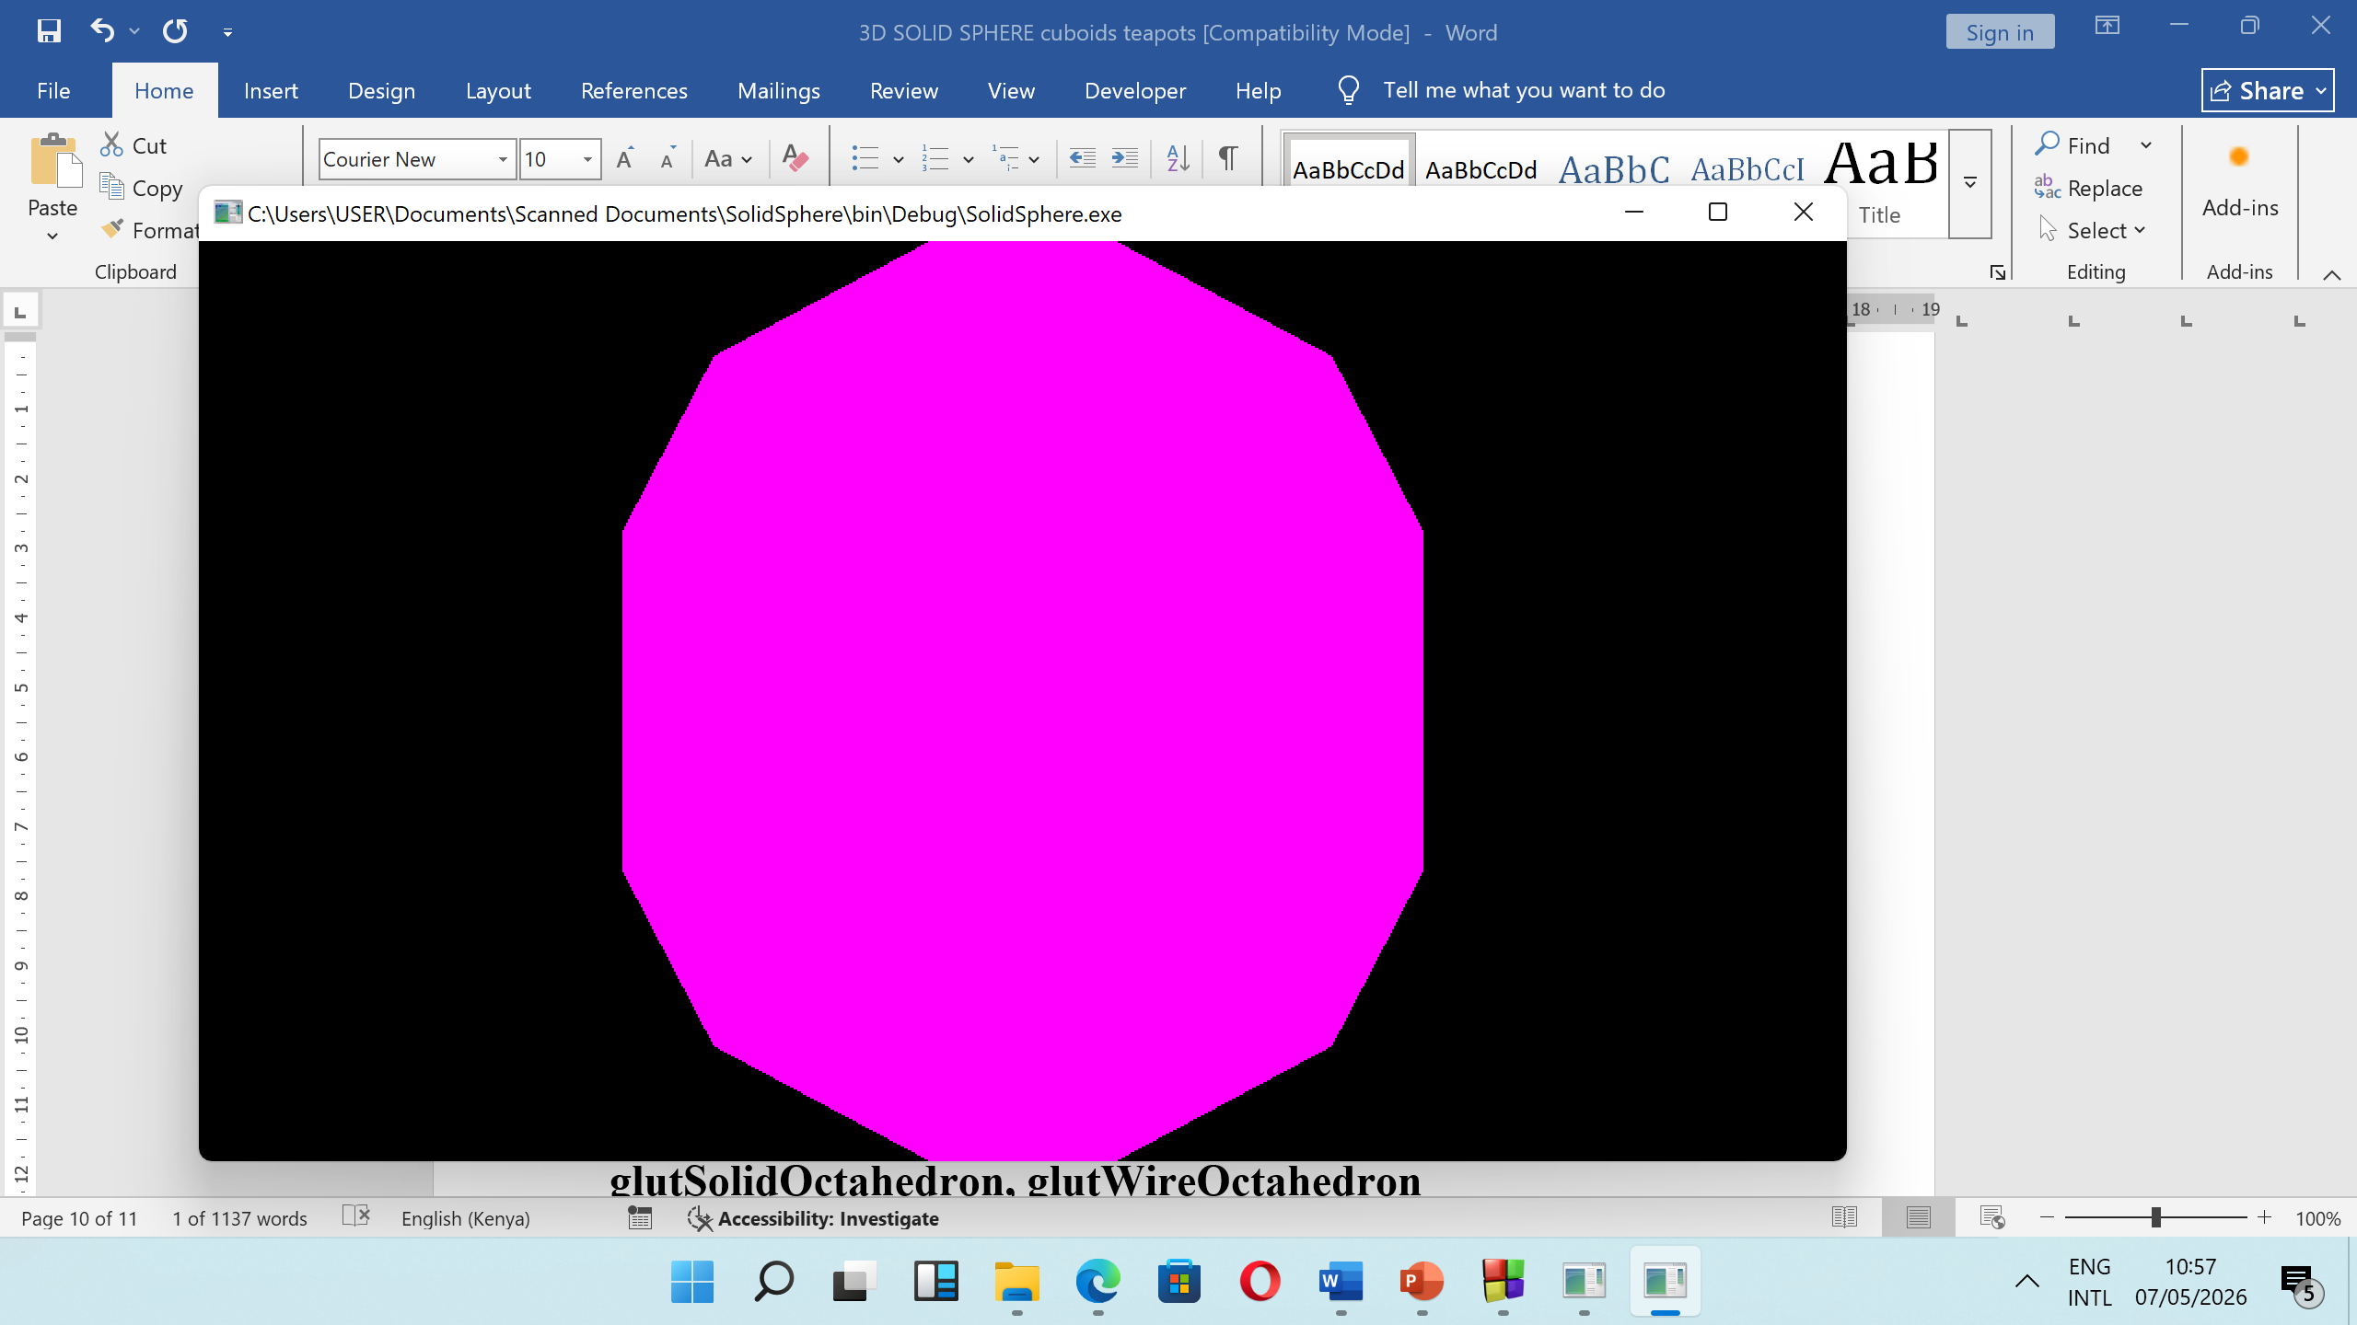
init ();
glutDisplayFunc(display);
glutReshapeFunc(reshape);
glutMainLoop();
return 0;
}
Output

Slide 28
Program (Wire Dodecahedron)
#include <GL/glut.h>
void init(void) {
glClearColor (0.0, 0.0, 0.0, 0.0);
glShadeModel (GL_FLAT);
}
void display(void) {
glClear (GL_COLOR_BUFFER_BIT);
glColor3f (1.0, 0.0, 1.0);
glLoadIdentity (); /* clear the matrix */
/* viewing transformation */
gluLookAt (0.0, 0.0, 5.0, 0.0, 0.0, 0.0, 0.0, 1.0, 0.0);
glScalef (1.0, 2.0, 1.0); /* modeling transformation */
glutWireDodecahedron();
glFlush ();
}

Slide 29
void reshape (int w, int h){
glViewport (0, 0, (GLsizei) w, (GLsizei) h);
glMatrixMode (GL_PROJECTION);
glLoadIdentity ();
glFrustum (-1.0, 1.0, -1.0, 1.0, 1.5, 20.0);
glMatrixMode (GL_MODELVIEW);
}
int main(int argc, char** argv) {
glutInit(&argc, argv);
glutInitDisplayMode (GLUT_SINGLE | GLUT_RGB);
glutInitWindowSize (500, 500);
glutInitWindowPosition (100, 100);
glutCreateWindow (argv[0]);

Slide 30
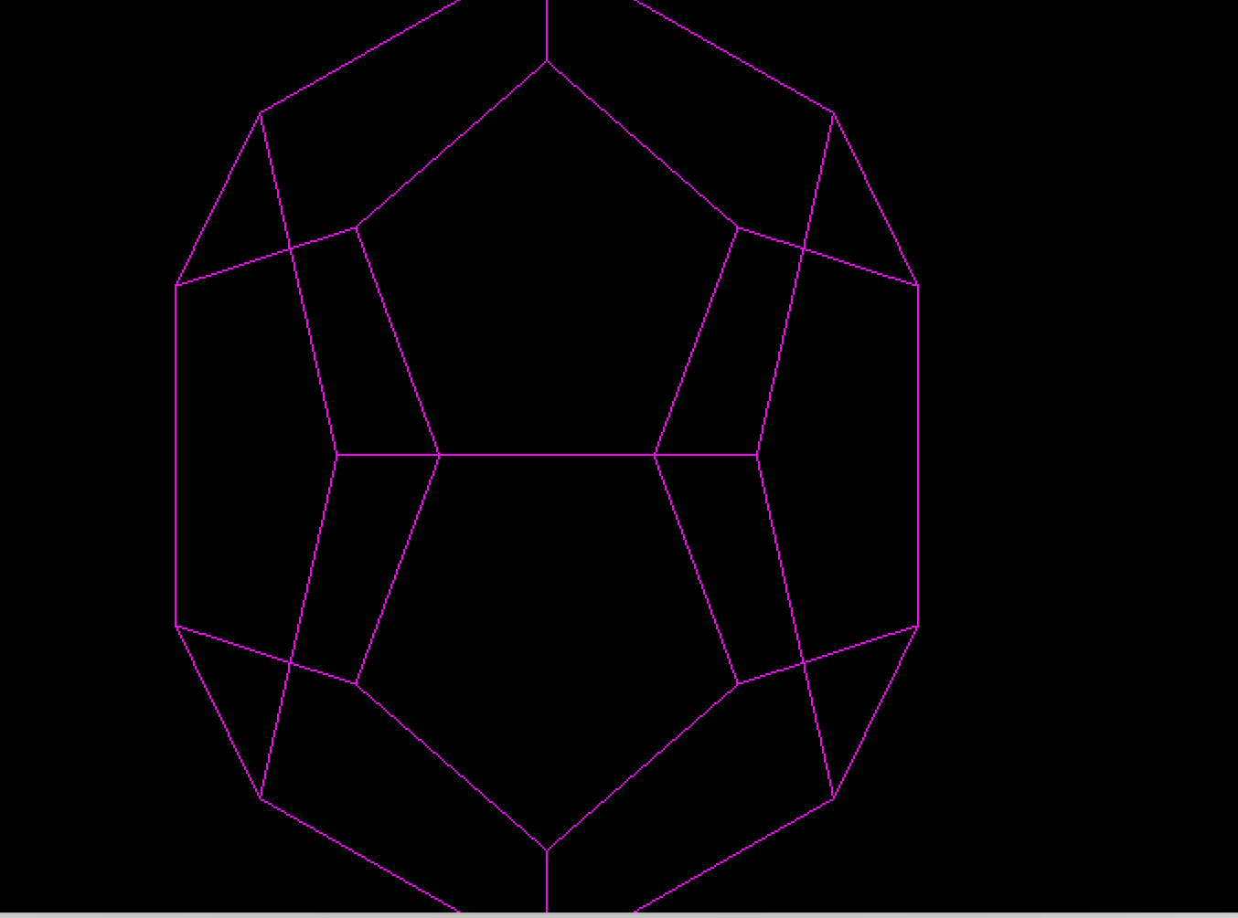
init ();
glutDisplayFunc(display);
glutReshapeFunc(reshape);
glutMainLoop();
return 0;
}
Output

